Slide 1
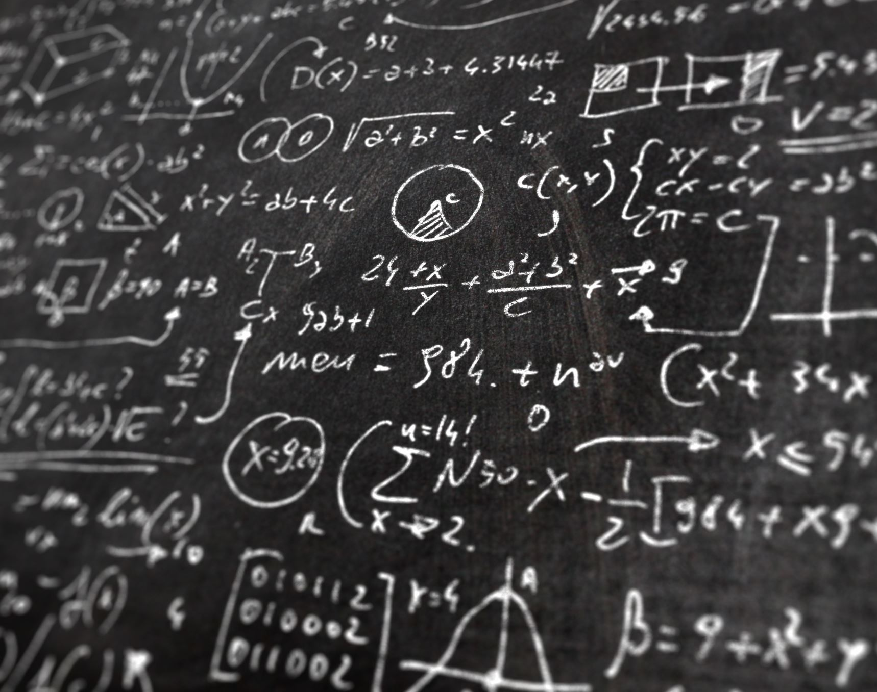
Elements Of Digital Storytelling

Slide 2

Structure
Linear: The story follows a straightforward beginning, middle, and end sequence. .
Example: A short film or a presentation where the plot moves from start to finish without any interruptions or flashbacks.
Side-Branches: This allows for some deviation from the main story, where side stories or additional content is available, but they eventually come back to the main narrative.
Example: Interactive websites where users can click on links to explore more information but return to the main story path.
Non-Linear: The story does not follow a chronological order.
. Example: Games or websites where users can choose their own path or explore different parts of the story in any order.

Slide 3
Assets

Slide 4
Assets
Photos: Visual images that capture key moments or settings in the story.
Videos: Moving images that help narrate the story, add dynamic visual appeal, and convey action or emotion.
Audio: Sound elements like voiceovers, background music, or sound effects
that enhance the storytelling experience.
Text: Written words that provide information, dialogue, or narration.
Graphics: Illustrations, infographics, or other visual representations
that add a creative or explanatory layer to the story.

Slide 5
Design

Slide 6
Composition: How the elements of your story (images, text, and videos) are arranged within the storytelling platform
01
Layout: The overall organization of the story's content, including how the text, images, and other assets are positioned
02

Slide 7
Technology
Web | App | Game | Slideshow | Videos

Slide 8
Accessibility

Slide 9

How & Where Does the Audience Consume It?
This considers the platforms and devices on which the audience experiences the story.

Slide 10
Intellectual Property (IP)

Slide 11
Types
Four types:
Patents: For inventions, like a new phone technology or medical drug.
It gives the inventor exclusive rights to use, sell, or license the invention.
Trademarks: For brand identity, such as logos or slogans (like the Nike swoosh or Apple's logo).
It distinguishes a company’s products from competitors.
Copyright:
For artistic works, including books, music, films, software, and paintings. It protects the creator’s right to control how their work is used.
Trade Secrets:
Confidential business information that gives a company a competitive edge, like Coca-Cola’s secret recipe.

Slide 12
Real-World Examples
Patent:
technology behind Tesla's electric cars.
Trademark:
McDonald’s golden arches logo.
Copyright:
A musician’s album or a filmmaker’s movie script.
Trade Secret:
Recipe for KFC's fried chicken.

Slide 13
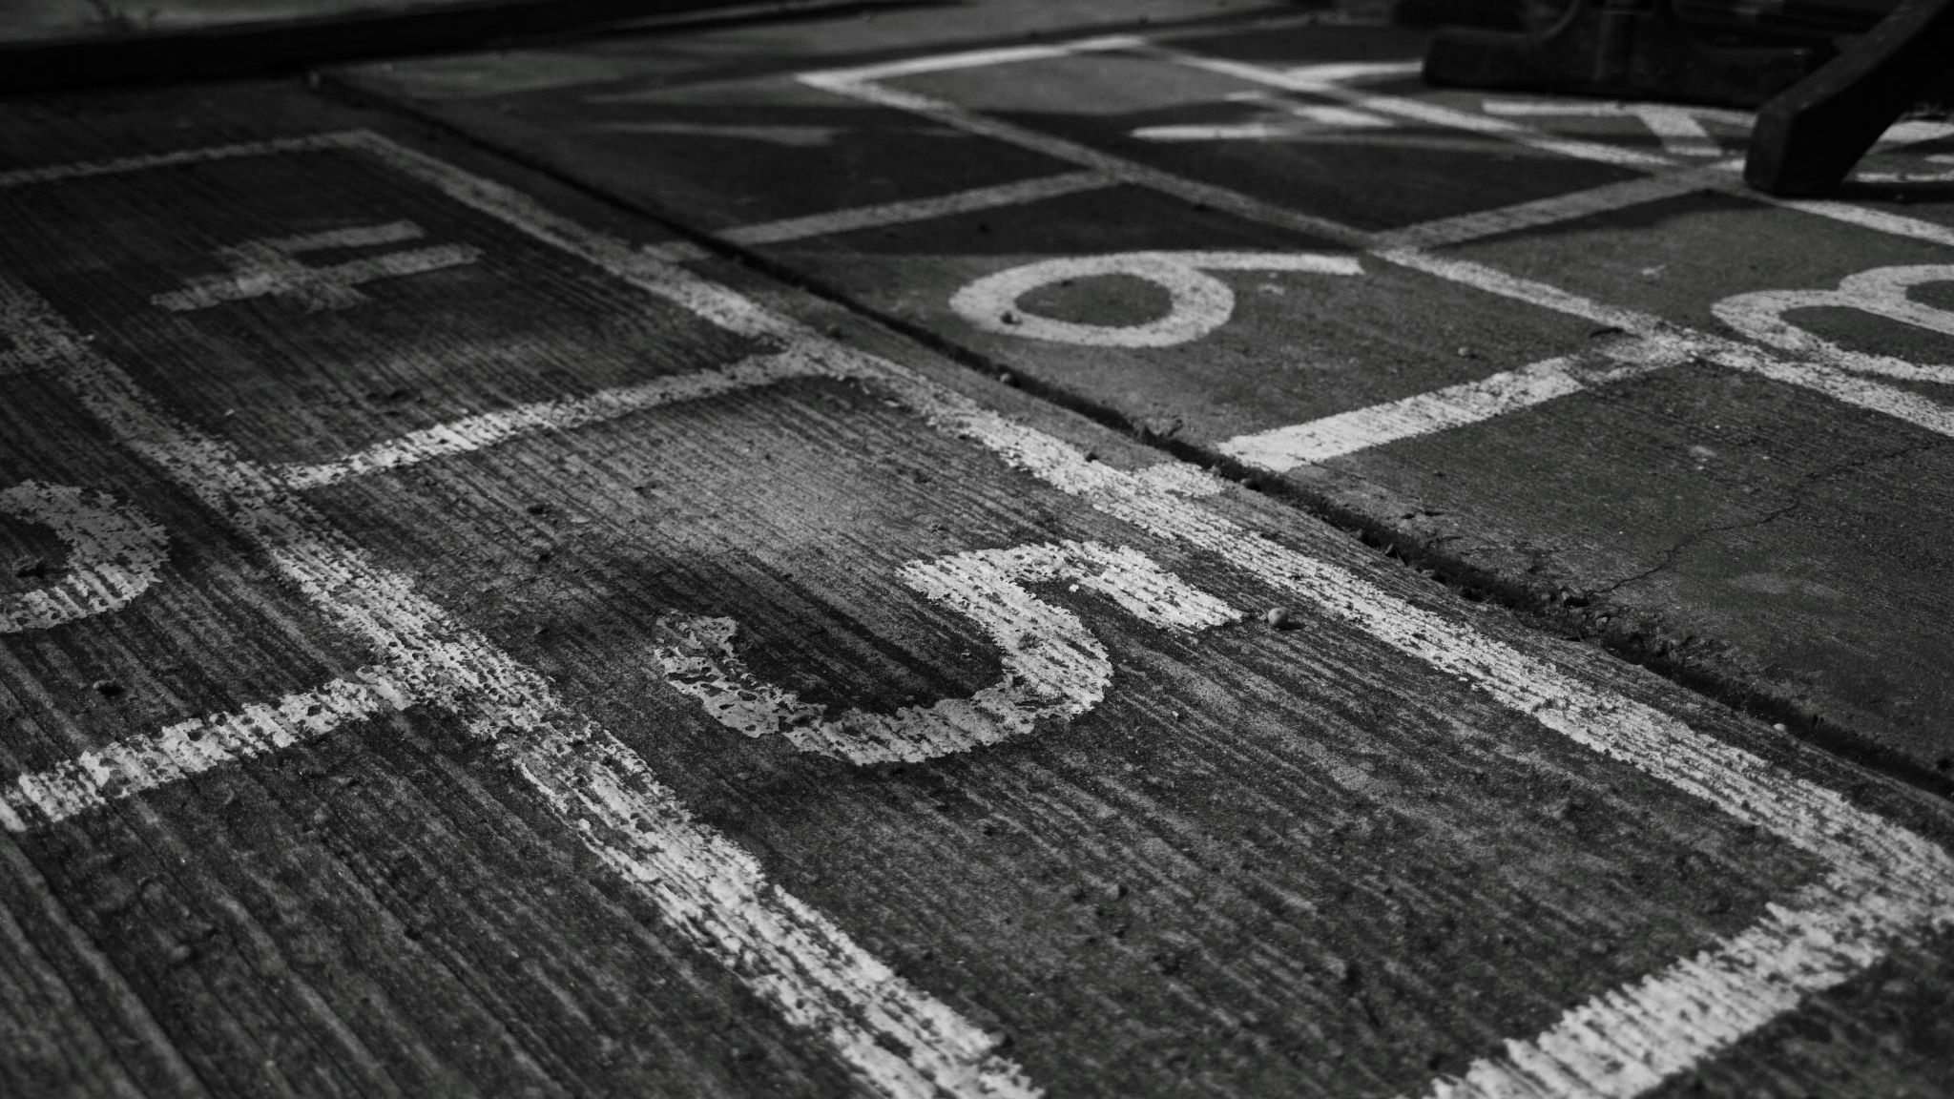
Need of IP

Slide 14
Why
It encourages innovation because creators know their work will be protected.
It helps companies build a strong brand identity.
It supports the economy by allowing inventors and creators to benefit financially from their work.

Slide 15
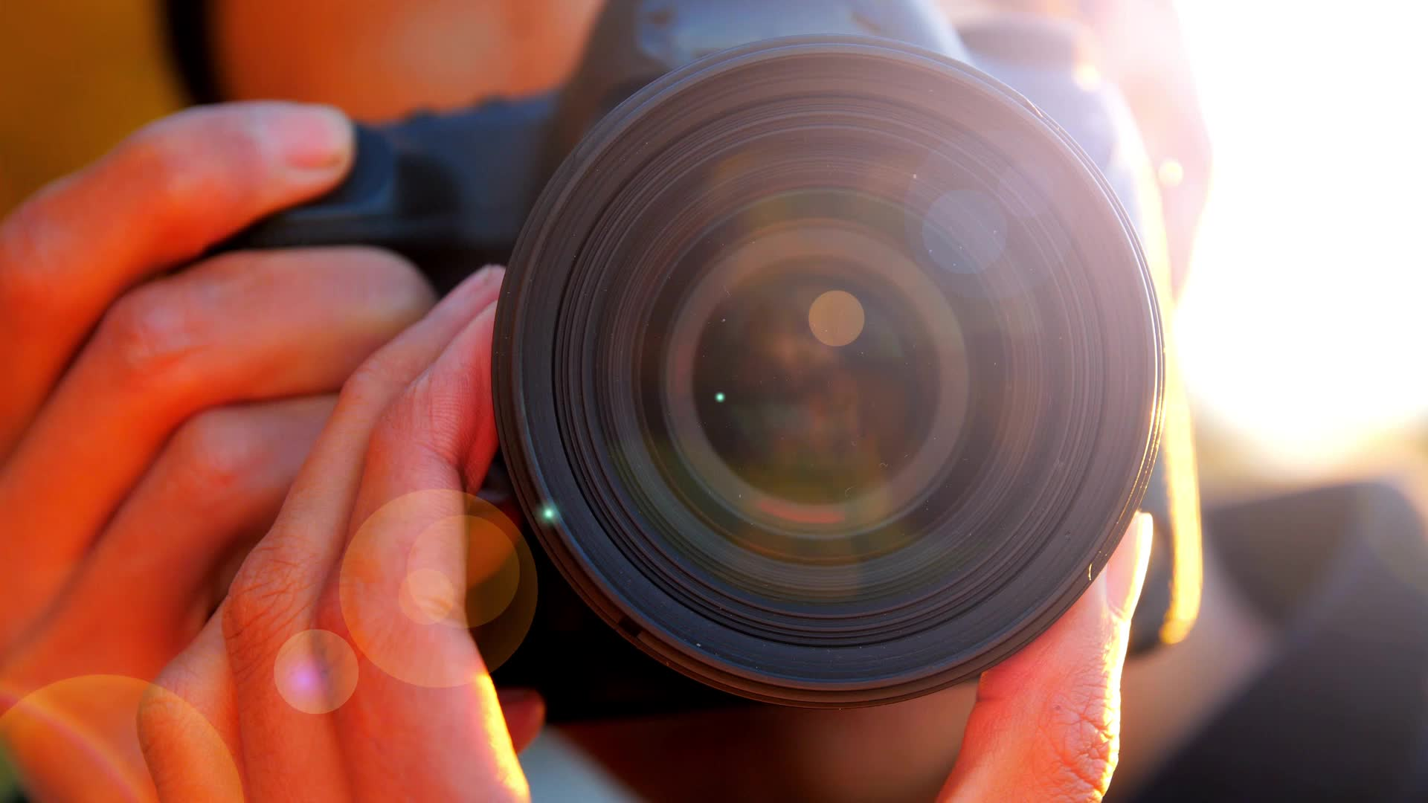
Photography

Slide 16

Types of Photography

Slide 17

Portrait Photography: Capturing people and expressions.
Landscape Photography: Focusing on nature, scenery, and outdoor environments.
Documentary Photography: Telling stories or documenting real-life events.
Wildlife Photography: Capturing animals and their natural habitats.
Macro Photography: Photographing small subjects, such as insects or flowers, in great detail.
Fashion Photography: Focused on clothing and other fashion items,

Slide 18

How Exposure Works

Slide 19

Light: it's natural or artificial
is where exposure begins.
The amount and intensity of light directly affect the exposure of an image.
Lens:
It directs this light through the camera’s aperture.
The quality and type of lens also impact how much light is transmitted.

Slide 20
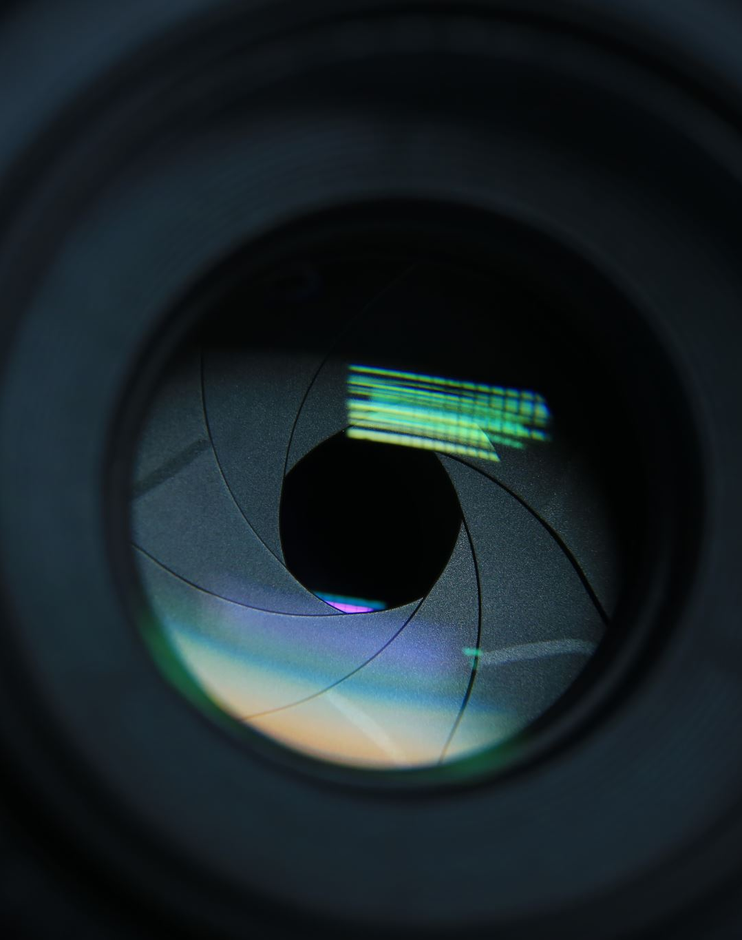
Aperture: It controls how much light passes through the lens by changing its size.
A wider aperture lets in more light, while a smaller aperture reduces the amount of light.
Opened Shutter: The shutter opens for a specific amount of time, allowing the light to pass through. The length of time the shutter remains open is known as shutter speed.
A faster shutter speed allows less light, and a slower shutter speed allows more light to reach the sensor.
Image Sensor: This is the part of the camera where the light is captured and converted into an image.

Slide 21

Cornerstones of a great exposure

Slide 22
Principles of photography

Slide 23
Sharp Focus with Crystal Clear Details
Ensuring the subject is in sharp focus.

Slide 24

Great Composition
Composition refers to the arrangement of elements within the frame

Slide 25

Alignments
Proper alignment of elements, such as horizontal or vertical line

Slide 26

Intent
Every photograph should have a purpose or message. Whether it's capturing an emotion, documenting a moment, or telling a story, having clear intent gives the image depth and meaning.

Slide 27
Photography
Rule of Third

Slide 28
Rule of Third
Divide the Frame
Photo divided into nine equal parts by two equally spaced horizontall lines and two equally spaced vertical lines.
key Spots:
Balance and Harmony:

Slide 29
Thank you

